Slide 1
Rent-Geared-to-Income (RGI) Applications
How to Complete the RGI Application
Notes:
Good afternoon, the Housing access centre has stopped receiving incomplete applications. In doing this we are giving a webinar regarding the application process.

Slide 2
RGI / Community Housing Application Process
Eligibility
Application requirements
RGI application form
Building selection form(s)
Completed building selection form(s)
How to submit the application
What happens next?
Notes:
We will be going over Basic Eligibility, Basic Application requirements, the RGI application form, Building selection forms, Completed building selection forms
How to submit the application and what happens next

Slide 3
Checklist for a Complete Application
Notes:
This slide is on our website at www.london.ca under living in london, community service, homeless prevention.
This is a great tool and can be downloaded to keep it handy
As you can see there are two parts to the checklist part one - the everything we absolutely need for the basic application to be complete
Signed copy, ID proof of status in Canada, income sources, and a completed building selection form
Part two are documents needed if there are arrears – a repayment agreement with housing provider arrears are owed to
shared custody- a shared custody agreement or child tax benefit notice
A signed divestment form if a member owns a property,
Proof of pregnancy note from doctor or ultrasound with applicants name and date of birth
Full time students over the age of 18 need, proof of enrollment in full time studies from an accredited education institution

Slide 4
Step 1: Determine Basic Eligibility
16 years+
Proof of status in Canada
No deportation order, departure or exclusion order under the Immigration Act.
No arrears to any community housing provider in Ontario, or they have a repayment agreement which is in good-standing.
Your household’s annual income must be below the household income limits for your community.
Notes:
To qualify for community housing in the City of London and the County of Middlesex, applicants must:
Be 16 years of age of older and be able to live independently.
Each member must be a Canadian citizen, landed immigrant or refugee claimant.
No member of the household has a deportation order, departure or exclusion order under the Immigration Act.
No member of the household owes arrears for either rent or damage to any community housing provider in Ontario, or they have set-up a repayment agreement which is in good-standing
Your household’s annual income must be below the Household income limits for your community.

Slide 5
Household Income Limits
Income must be below the HILs
*This is for general reference. A family may have more than 2 adults.
Area | 1 Bedroom | 2 Bedroom | 3 Bedroom | 4 Bedroom
Household Size* | 1 adult or Couple | 1-2 Adults + 1-2 Dependents | 1-2 Adults + 2-4 Dependents | 1-2 Adults 3-6 dependents
Municipality of Middlesex Centre, City of London Municipality of Thames Centre | $41,500 | $49,000 | $58,000 | $74,500
Rest of the service area | $34,000 | $40,500 | $45,000 | $59,500
Notes:
The household income limits are as such for a 1 bedroom an adult or couple the applicant must not make more than $41,500,
For a two bedroom 1 or 2 adults which could be a grandparent and 1 or 2 dependents, the applicants must not make more than $49,000, and so on
The unit size the applicant is eligible for is based on the size of the household
If there is one adult and a child then a two bedroom would be what to look at in terms of how much the applicant should make
The bottom totals are for the rest of Middlesex County outside of the municipality of Middlesex centre or thames centre and are lower
A family may have more than 2 adults.

Slide 6
Step 2: Complete the Application Form
Notes:
Now let’s see how to complete an application form

Slide 7
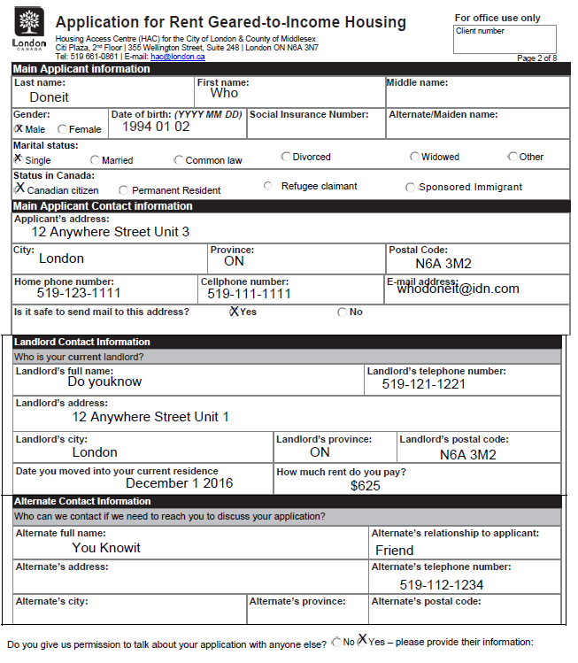
Application
TIPS:
Read the questions carefully
Answer all the questions
An alternate contact is highly recommended
Notes:
This slide and next 7 slides shows what the application should look like
Fill out as much as possible noting the name, date of birth, address and phone number is really key. We need the contact information so that when the applicant does get to the top of the waitlist the housing provider can contact them. If there is not an address or phone number, put down an alternate contact.

Slide 8
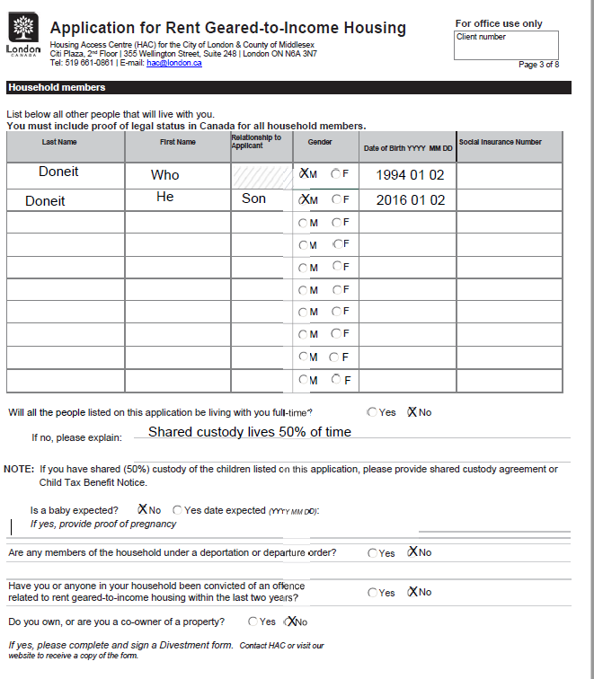
TIPS:
Include all of the members of your household who will be living with you and their birth dates.
If you have shared custody, include the Child Tax Benefit notice, or a custody agreement.
Include an ultrasound or letter from a doctor if a household member is pregnant.
If you own or co-own property, a Divestment form must be filled out.
Notes:
On this page the applicant would list who will be living with them,
Answer all the questions
The application gives help if the applicant answers yes to most of the questions by telling what documents are required to send in
Only the first question is a step to follow if the applicant answered no about custody

Slide 9
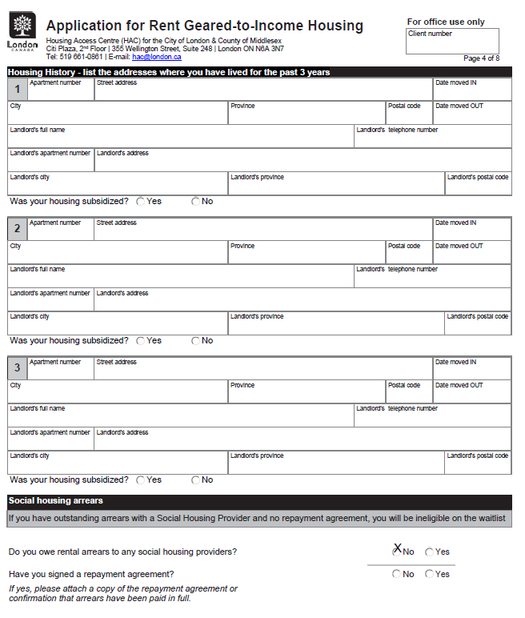
TIPS:
Provide your housing history.
Proof of an arrears repayment agreement if you have one.
If you aren’t sure about arrears, we will check our system for you.
Notes:
List the housing history if it is possible
The most important thing on this page is if the applicant owe arrears, it will then lead the applicant to the next question below regarding a repayment agreement and how it is needed.
If the applicant is not sure about owing arrears we can check our system

Slide 10
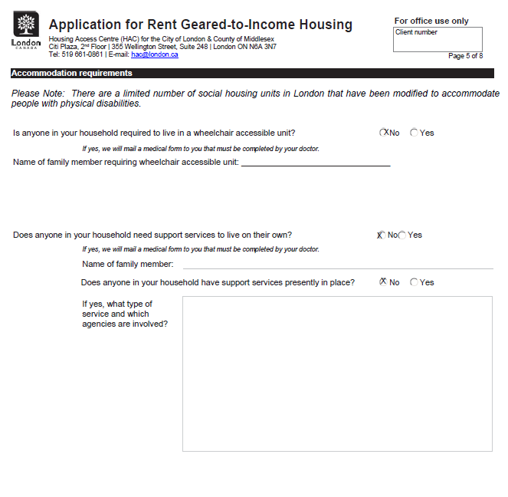
TIPS:
If you need a wheelchair accessible unit please provide a Doctor’s note.
If specialized supports are needed for a family member to live independently, we will need a form completed by a doctor or other support indicating that support is in place.
Notes:
Please let us know if a wheelchair accessible unit is needed, if yes please attach a doctors note
Please know that these units have lower counters and wider doors for wheelchairs and may be uncomfortable for those who are not in a wheelchair
If someone needs specialized supports, we also need a form completed by a doctor or other support workers indicating the support is in place

Slide 11
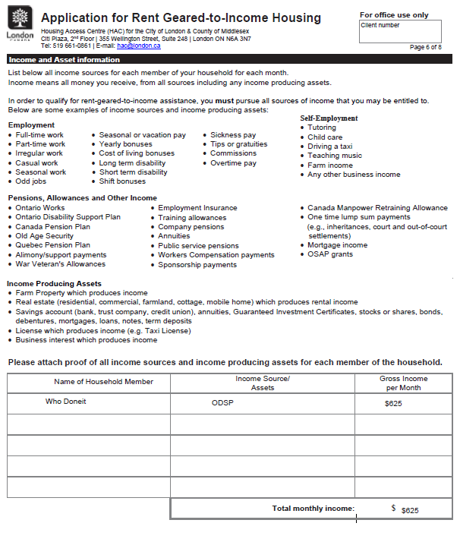
TIPS:
Each family member over 18 must be included in the income table.
Provide proof of income with your application.
If employed: 3 months of pay stubs.
OW/ODSP – cheque stubs, or a letter from your case worker.
OAS/CPP or other: notice or bank statement*
Notes:
This page lists examples of income sources. Please provide proof of that income. If the applicant is employed we need a letter from the employer with details of hours worked and wages or 3 months of pay stubs, if the applicant is on social assistance a statement or letter showing the amount received. If the applicant receives OAS or CPP a statement, notice or bank statement that clearly shows that is what is deposited.
We need income from all household members who are over the age of 18 and are not in school. A missing income will mean incomplete, and the application will not be accepted
We do not accept Notice of Assessments we need recent income and NOA’s do not provide that.

Slide 12
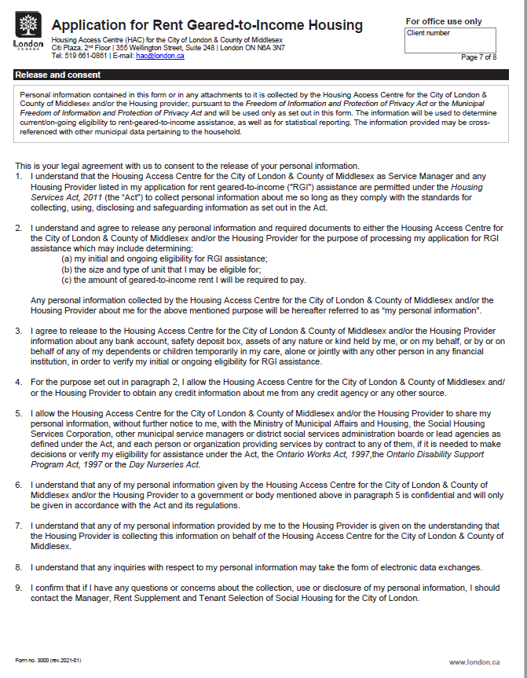
TIPS:
Read Carefully
This is consent to release your information for the purpose of processing your application and getting an offer of housing.
Notes:
Please read or have your applicant read fully the consent to release information. The application is incomplete if there is no signature of all household members over the age of 18

Slide 13
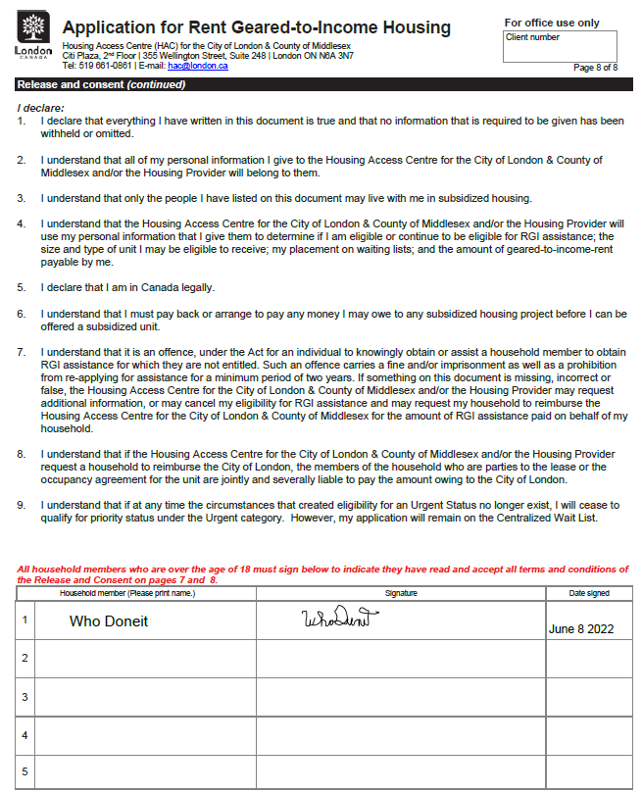
TIPS:
All household members over 18 must sign and date
Notes:
Here is where the signature is needed for all members over the age of 18
Only a name will not be accepted, we need a signature

Slide 14
Building Selection Form
Adult, Family, Senior options
Choose which form(s) applies to you based on your household.
Notes:
We have three building selection forms, Adult, Family and Senior
Please choose which form applies to the applicant household.
The buildings have different sized units depending on the demographic they are intended for
Adult buildings typically serve single or couple occupants
Family buildings typically serve families
Senior buildings serve seniors
Housing providers in seniors buildings will only choose those who meet the age requirement

Slide 15
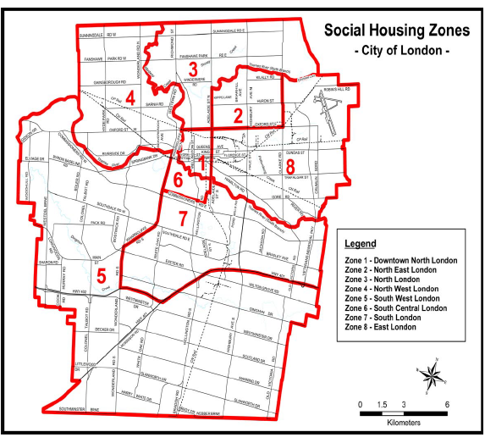
TIPS:
Decide which areas you want to live in.
Consider transit, proximity to resources – schools, medical centres, and other services your household needs.
Notes:
On the building selection form it shows a map of London and the different zones listed, the county units are not shown on this map but are present in the form itself
There is only one offer, please consider transit, proximity to resources such as schools, medical centres, employment and other services your household needs

Slide 16
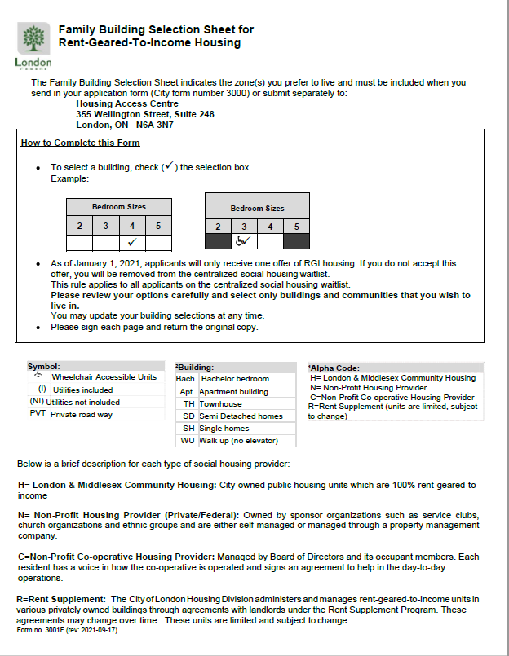
TIPS:
If you require a wheel chair accessible unit, select units with the wheelchair icon.
Co-op housing will require your household to help out.
Rent Supplement units are in privately owned buildings and can have longer waitlists.
Notes:
The sheet shows how to complete the form
Choose the bedroom sizes, if a wheelchair accessible unit is required select the units with the wheelchair icon
There is a menu in the middle that identifies what each shortform is – I means utilities included, ni - means utilities are not included
B a c h is a bachelor bedroom, a p t is apartment building, t h townhouse etc
The alpha codes mean what housing provider the address is managed by H is LMCH, N is non profit, C is coop and R is rent supplement
Coop housing will require your household to help out in the complex
Rent supplement units are in privately owned buildings and do have longer waitlist

Slide 17
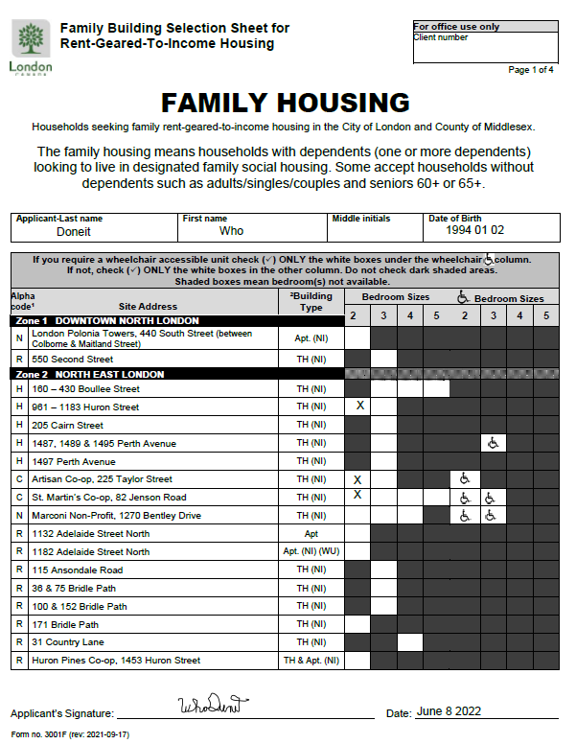
TIPS:
Be sure to put your name on the top of the form.
The unit size you are eligible for is based on the size of your household and will be communicated to you when you receive an eligibility letter.
Notes:
Be sure to put the applicants name on the top and sign the bottom
The unit size the applicant is eligible for is based on the size of the household
If there is one adult and a child then a two bedroom
Two adults that are a couple require a one bedroom
The dynamics could be very different for each household

Slide 18
Step 3: Gather Your Documents
Notes:
This sheet is again on the website www.london.ca/livinginlondon/Communityservices/homeless prevention
Please read it before you submit all the documents
Please check our website before submitting the application to make sure your documentation is correct

Slide 19
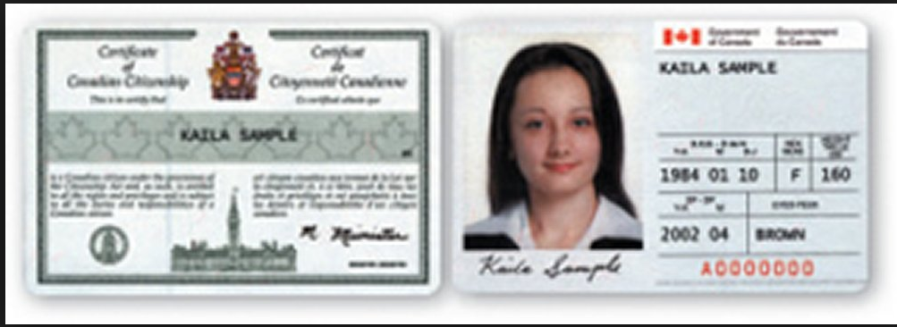
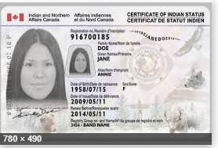
Proof of Canadian Citizenship
Notes:
Proof of Canadian citizenship documents may vary, but here is an example of what we accept
A health card, or drivers license or identification card are not accepted. the application will not be permitted if we do not have ID for all household members
If there are 2 adults and a child on your application, there need to be 3 proof of id’s

Slide 20
Proof of Status in Canada
Please refer to the required identification document on our website.
We DO NOT accept Ontario ID cards, driver’s license, or health cards as ID.
Picture ID may be required by the housing provider at the time an offer of housing is made.
Notes:
Read screen

Slide 21
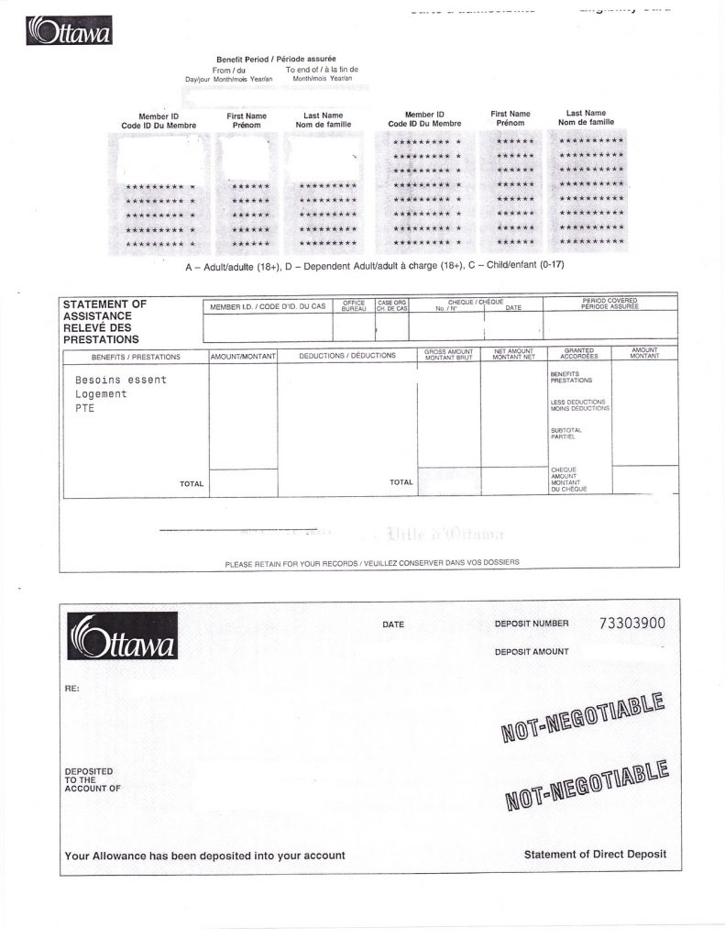
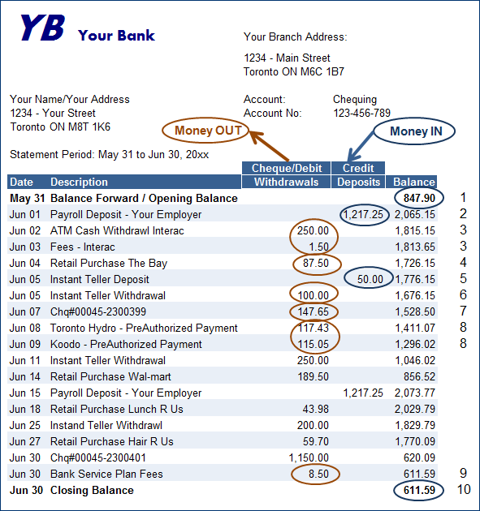
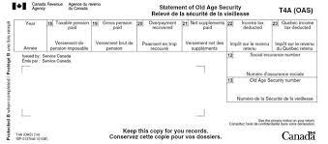
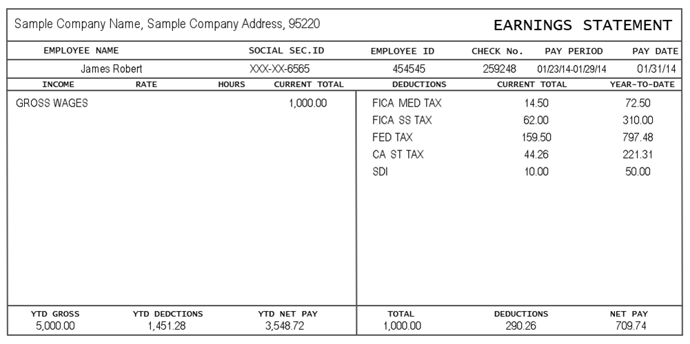
Income Verifying Documents
Notes:
This slide gives another example of income verification documents
Bank account we need to see the deposit and that it clearly shows what source of income the applicant is getting
OW/ODSP statement
OAS or CPP Statements
Earnings statement from employment

Slide 22
Custody Documents
You must provide custody documents, or a Child Tax Benefit statement verifying the arrangement
Notes:
If you are looking for a bedroom for a child that you share custody with we need custody documents

Slide 23
Step 4: Submit your application
In-person or by mail
City of London, Housing Access Centre,
355 Wellington Street, Suite 248
Email
hac@london.ca
Please note: we do not accept photos of applications by mail or email.
Notes:
Submit your application in full in person or by mail to the address on the screen or by email at hac@london.ca
When emailing please scan the entire application package, including id, income and building selections and any other documents that are needed
Do not send each page separately or by photo. If a full document scan cannot be done please send it by mail or in person
Do not send protected emails we cannot open them,
Do not send zip emails we cannot open them
We no longer accept faxes

Slide 24
Urgent & Priority Applications
Special Priority Households (Human Trafficking & Domestic Violence)
Urgent – Homeless, Social, Medical
Information & forms for households with prioritized status are available on our website.
Webinars for these topics & others will follow in the coming months.
Notes:
Urgent and priority applications are supplemental to the rgi application. If we receive an urgent application and there is no rgi application on our file it will be sent back
Please do not send more than one urgent application for the same person. An urgent is an urgent is an urgent
Information and forms for households with prioritized status are available on our website
Webinars for these topics are coming soon

Slide 25
Incomplete Applications
Incomplete applications will be returned to the applicant with an explanation of what is missing.
Notes:
Incomplete applications will be returned in the fashion we received them
Mail will be returned by mail
Email will be returned by email
Front counter will give back incomplete applications

Slide 26
Complete Applications
Complete applications will be processed in the order they are received (priority applications are processed first).
A letter of eligibility or ineligibility will be sent to the applicants address on file.
Due to the high volume of applications, there is currently a delay in processing applications.
Notes:
Complete applications will be date stamped the date we receive them, put into our tracking system to be later processed into our file and data base
Special priority applications are processed first due to legislation for victims fleeing from abuse
Once processed a letter will be sent to the address we have on the application of eligibility
The application date stands no matter when we process it. We have a backlog of applications we are working on now. Currently we are processing applications received from June 2022

Slide 27
I am on the waitlist now what?
RGI Housing is not emergency housing.
There is a lengthy wait for housing.
Each building maintains its own waitlist.
Wait-times depend on several factors.
The Housing Access Centre cannot tell you how long the wait may be.
Notes:
RGI is not emergency housing
Once the applicant is on the waitlist their names go on the buildings they have selected.
Once there is a vacancy and the applicants name is at the top of the list the housing provider will contact the applicant directly
Wait times will vary depending on many variable, area, buildings selected, number of bedrooms, time of year etc.
This is important the housing access centre does not know when or where the next vacancy will occur
You cannot rank your buildings. You must take the first offer that comes up or your application will be cancelled

Slide 28
To be successfully housed
UPDATE your contact information with the housing access centre every time your address, email or phone number changes.
Designate an alternate contact who knows how to find you and let them know you are expecting a call.
Check your email regularly.
Make sure there is minutes on your phone and room on your voicemail.
Check with the agency that you have your HIFIS account with.
Respond to housing offers as soon as you receive them.
Make sure you have the building selections you want.
Have photo ID ready for the housing provider.
File your taxes annually.
Notes:
READ SCREEN
reach out to the housing access centre every 1 to 2 years to ensure your application is still eligible

Slide 29
Questions
Please reach out to our team if you have any questions or concerns
hac@london.ca
Notes:
Thank you for your time, I hope that this webinar has been useful and informational
Jessie do we have any questions?

